Slide 1
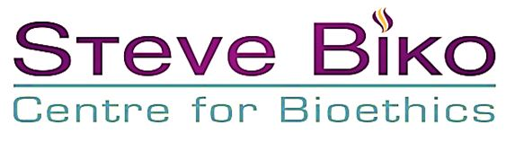


Somatic and Germline Therapy, Prevention,
and Enhancement Applications:
A South African Perspective
Prof. Kevin G. Behrens

Slide 2

South African Views on Gene Editing
As diverse as everywhere else
Fewer concerns about basic research than somatic interventions than germline interventions
Fewer concerns about germline research intended for preventing disease than for enhancement
Openness to cautious, regulated use
Some fundamental objections on grounds of going “against nature”, “playing God” or sanctity of life
Notes:
In South Africa, opinions on the ethics of human gene editing vary widely. As is true elsewhere, generally there are fewer ethical concerns about basic research than somatic interventions and fewer concerns about somatic interventions than germline interventions. Similarly, germline interventions aimed at preventing inherited diseases are more likely to be supported than those intended for enhancement purposes. Mostly, I think there is an openness to some cautious use of these technologies, subject to quite strict regulation and monitoring. However, there are some who hold fundamental objections to these technologies almost in their entirety. Here the grounds for objecting are mostly familiar: this would be playing god or going against nature. In the case of the more narrow rejection only of the editing of the genes of zygotes or embryos, familiar arguments based on a notion of the ‘sanctity of life’ are common. These views are strongly and sincerely held by significant sectors of the population, and, as such must be taken into serious consideration. However, since these fundamental concerns about gene editing have received much attention already, I will set them aside for this talk, and instead focus on some key notions in indigenous African thought and philosophy and what they possibly entail for an ethical appraisal of human gene editing.

Slide 3
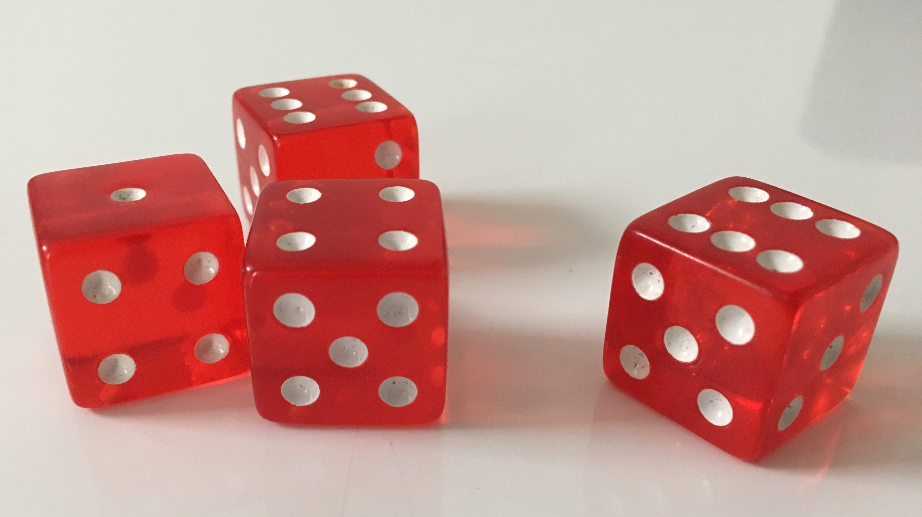
Two Important Common Concerns
Risks involved
Especially risks of unforeseen harm
Many in favour of applying precautionary principle until science is clearer
Notes:
But, before I do that, there are two other common concerns about gene editing that are also expressed by South Africans. Those who raise these concerns do not generally foresee rejecting these technologies entirely, but they do recommend caution in their application. The first concern revolves around the risks involved in gene editing research and applications, especially the risks of unforeseen harms. I suspect most South Africans who know about these technologies would favour applying the precautionary principle and not moving too hastily into such unchartered territory.

Slide 4

Two Important Common Concerns
Risks involved
Especially risks of unforeseen harm
Many in favour of applying precautionary principle until science is clearer
2. Equity
Conscious of differences in wealth, power between developed & developing world
Fear based on past experiences of Africans being used in trials with no benefit to Africa
Concerns about “elitist” medicine
Notes:
The second concern revolves around equity issues. As a developing country in the global South, we are conscious of the huge discrepancies in wealth, infrastructure and power between the developing and developed world. There are deep worries that research into and implementation of interventions based on gene editing will serve the needs only of the rich and powerful; that this will become another example of elitist medicine. There are also justice concerns grounded in past experiences of Africans bearing a disproportionate burden as trial participants for treatments that have not become readily available to the citizens of this continent. I want to emphasise the importance of the global community’s taking these concerns very seriously indeed.

Slide 5
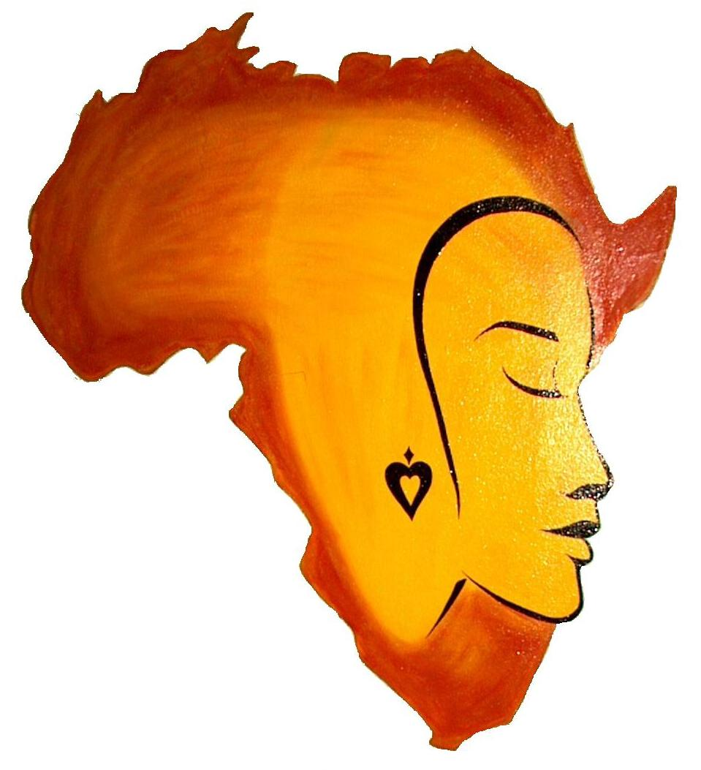
Three Indigenous African Notions:
Implications for Gene Editing
The notion of “life force”
Moral obligations to future generations
Preference for decision making by consensus over majoritarianism
Notes:
But, for now, let me set these matters aside, and turn to my main objective with this talk: namely, to draw on characteristically African ethical conceptions for guidance in navigating our way through this area that is so fraught with moral dilemmas and ethical questions. I will be referring to a few salient African values or ethical notions and tentatively teasing out what they might entail for human gene editing. Africa is a large continent, with a huge diversity in cultural-linguistic groups, each with their own values, mores, beliefs and traditions. I do not claim that there is a single African worldview. But, I do claim that there are some broad philosophical and ethical notions that are widely shared among the people of sub-Saharan Africa, and I base my discussion on some of these. I also do not suggest that these notions are unique to Africa. In fact, I strongly suspect that there are other non-western societies that may have similar conceptions.

Slide 6

Three Indigenous African Notions:
Implications for Gene Editing
The notion of “life force”
“Life-force has been traditionally interpreted as an intrinsically valuable energy that is imperceptible and constitutes everything that exists. All things in the universe, even apparently inanimate objects such as a grain of sand or drop of oil, are thought to be both good and real by virtue of having some degree of life-force…
All beings in the world are thought to participate in the divine energy.”
(Metz 2018).
Notes:
Suitably protected by these disclaimers, let me proceed to the first salient African notion that I think is of relevance. This is the idea that all entities have a ‘life force’ or ‘vital force’. Thaddeus Metz describes this conception thus:
Life-force has been traditionally interpreted as an intrinsically valuable energy that is imperceptible and constitutes everything that exists. All things in the universe, even apparently inanimate objects such as a grain of sand or drop of oil, are thought to be both good and real by virtue of having some degree of life-force, with plants having a greater share of it than rocks, animals having more than plants, human beings having more than animals, ancestors (whose bodies have died but who live on in an imperceptible realm on earth) having more than humans, and God, the source of all life-force, having the most. All beings in the world are thought to participate in the divine energy. (Metz 2018).

Slide 7
Three Indigenous African Notions:
Implications for Gene Editing
The notion of “life force”
“Every illness, wound or disappointment, all suffering or fatigue, every injustice and every failure; all of these are held to be, and are spoken of by the Bantu as, diminution of vital force.” (Tempels, 1959: 46).
“…it is the task of the human person to study the cosmos in order to identify plants, animals, and minerals possessing that force which can liberate one from physical and psychic suffering.”
(Bujo: 1998: 211).
Notes:
Illness and mental distress are often thought to be associated with a diminishment of the life force of the individual and healing of body and mind can be achieved by restoring life force. Placide Tempels writes: “Every illness, wound or disappointment, all suffering or fatigue, every injustice and every failure; all of these are held to be, and are spoken of by the Bantu as, diminution of vital force” (Tempels, 1959: 46). This life force can be restored through potions, talismans or divination using objects believed to have their own vital force. Benezet Bujo writes “it is the task of the human person to study the cosmos in order to identify plants, animals, and minerals possessing that force which can liberate one from physical and psychic suffering… Hence, the traditional healer in Africa does not only include the community of the living and the dead into his healing practices, he also uses natural elements like minerals, plants, pieces of wood, animal bones, teeth and hair, etc., (Bujo: 1998: 211). And, it may even be argued that there is a moral duty on us to do what we can to restore the life force of others when it is diminished.

Slide 8
Three Indigenous African Notions:
Implications for Gene Editing
The notion of “life force”
Open to the possibility of gene editing intended to heal
No more playing God or acting against nature than other traditional practices
Using ingenuity to augment waning life force of others is an intrinsically good act
Notes:
This way of thinking seems to me be open up the possibility of an acceptance of gene editing that is intended to heal or prevent illness. It would be no more playing god or acting against nature than many existing traditional healing practices are. If it is able to restore the life force of the sick, it is just another way healing. Using our ingenuity to augment the waning life force of others is an intrinsically good act. Of course, other interpretations are possible, and it is clear that many non-Africans will not be able to accept some of the unfamiliar metaphysical beliefs underlying this thinking. However, all I have hoped to demonstrate is that there is scope within African indigenous ideas for these technologies to find social and ethical justification.

Slide 9

Three Indigenous African Notions:
Implications for Gene Editing
Moral Obligations to
Future Generations
Notes:
The second salient African ethical conception I want to discuss has to do with moral obligations to future generations. The very idea that it is possible to have obligations towards beings we cannot know, that do not yet exist and who cannot reciprocate has been the subject of much philosophical debate for some time, especially within the context of environmental problems. In the West some argue that it is up to each generation to look after itself. Others concede that we might have some obligations to posterity, but that they should be discounted over time so that our responsibilities fade away after a few generations into the future

Slide 10
Three Indigenous African Notions:
Implications for Gene Editing
Moral Obligations to
Future Generations
A “…temporal myopia that infects modern [Western] society. The question of obligations to future generations is posed in terms of abstract obligations to possible future people who are strangers to us. The argument is premised on the lack of a sense of continuity of the present with both the past and the future.”
(O’Neill, 1993: 46).
Notes:
Of course there are also many in the West who do recognise duties to posterity, but it is clear that our collective behaviour hardly reflects that belief. John O’Neill describes a “…temporal myopia that infects modern [Western] society. The question of obligations to future generations is posed in terms of abstract obligations to possible future people who are strangers to us. The argument is premised on the lack of a sense of continuity of the present with both the past and the future (O’Neill, 1993: 46).

Slide 11
Three Indigenous African Notions:
Implications for Gene Editing
Moral Obligations to
Future Generations
“Of all the duties owed to the ancestors none is more imperious than that of husbanding the resources of the land so as to leave it in good shape for posterity. In this moral scheme the rights of the unborn play such a cardinal role that any traditional African would be nonplussed by the debate in Western philosophy as to the existence of such rights.”
(Wiredu, 1994: 46).
Notes:
By contrast, the prominent African philosopher Kwasi Wiredu writes: “Of all the duties owed to the ancestors none is more imperious than that of husbanding the resources of the land so as to leave it in good shape for posterity. In this moral scheme the rights of the unborn play such a cardinal role that any traditional African would be nonplussed by the debate in Western philosophy as to the existence of such rights.” (Wiredu, 1994: 46). While this is written in an environmental ethics context, Wiredu’s words reflect that moral obligations towards future generations have a central place in much African thought. His view is supported by many others such as Amuluche Nnamani, Felix Murove and Matthew Izibili. Indeed, it is not surprising that communities who speak of the recently dead as ancestors who literally continue to exert an influence of the living and are seen as their guardians and guides would understand moral obligations to posterity in this strong way. It is certainly considerably more clearly entrenched in African thought that we do have duties towards future people than it is in Western thought.

Slide 12
Three Indigenous African Notions:
Implications for Gene Editing
Moral Obligations to
Future Generations
Advises caution regarding germline editing
Until there is more certainty about effects on future people, we should not play Russian roulette with genes that can be passed on
Notes:
This very strong sense of obligations to future generations seems to advise caution about proceeding with research and treatment with germline editing. Until there is far more certainty about the effect of such interventions on future people, it would be unethical to proceed to interventions that would carry edited genes reproductively into future generations. The African sense of strong obligations to descendants suggests that we have a very profound and deep responsibility to not play Russian roulette with the genetics of future people. As Wiredu puts it, this is an ‘imperious duty”.

Slide 13
Three Indigenous African Notions:
Implications for Gene Editing
Moral Obligations to
Future Generations
Advises caution regarding germline editing
Until there is more certainty about effects on future people, we should not play Russian roulette with genes that can be passed on
BUT, the same strong duty to posterity might also provide moral justification for altering germline in the interests of future generations
Especially with respect to prevention of hereditary diseases
Notes:
Notwithstanding the need for extreme caution, this same strong duty to posterity could, paradoxically, also provide moral justification for altering the germline in the interests of future generations. Provided we would be able to do so safely and with minimal risk of harm, surely if we had the ability to rid the continent of sickle cell anaemia and the world of many hereditary diseases, an “imperious duty” to future generations would compel us to do so.
I tentatively conclude that the African strong sense of obligations to future generations might well ultimately justify germline editing, but that it would demand caution until we can do so safely and with confidence.

Slide 14
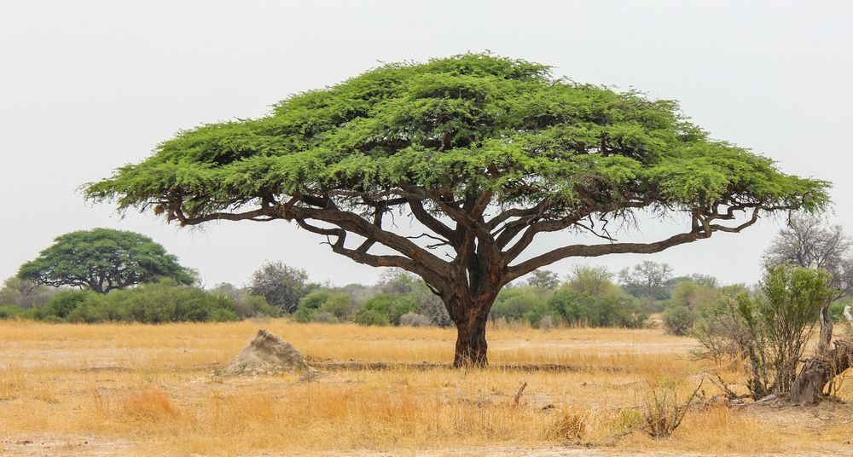
Three Indigenous African Notions:
Implications for Gene Editing
Preference for decision making by consensus over majoritarianism
Serious decisions made by getting community together to talk it out until sufficient consensus reached
The lesson to the global community is that decisions about something that can affect the future of our entire species should be made in collaboration, and that we should seek to hear as many diverse voices as possible
How representative is this meeting, really?
Notes:
Very briefly, I want to reflect on one more African traditional value, and that is the preference for decision making by consensus over majoritarianism. I take it is generally known that African communities often make serious decisions by getting the community together to talk it out until they find sufficient consensus to agree. In my country these meetings often take place in the shade of large thorn tree and known as a ‘lekgotla” or an “indaba”. It is not easy to replicate this system that works so well in a village on the global stage. But, the wisdom underlying this preference is that allowing all to have their say, involving all in a decision, and continuing to work until you have at least sufficient consensus makes for much better and sustainable choices. The lesson to the global community is that decisions about something that can affect the future of our entire species should be made in collaboration, and that we should seek to hear as many diverse voices as possible. To some extent, I preach to the converted, as this very gathering is intended to do just that. And I congratulate the organisers for this. But, as a final challenge, I ask you to look around this room and ask, just how representative is this meeting really? Can we not do better?

Slide 15
References
Bujo, B. 1998. The Ethical Dimension of Community. Nairobi: Paulines Publications
Metz, T. 2018. Addiction in the light of African values: Undermining vitality and community. Monash Biethics Review. Published on line first
O’Neill, J. 1993. Future Generations: Present Harms. Philosophy, 68: 35-51.
Tempels, P. 1959. Bantu Philosophy. Paris: Presence Africaine.
Wiredu, K. 1994. Philosophy, Humankind and the Environment. In Philosophy, Humanity and Ecology. Edited by Oruka, O. Nairobi: ACTS Press.

